Slide 1
Mathematical Induction

Slide 2
AN ANALOGY
Mario and the Ladder

Slide 3
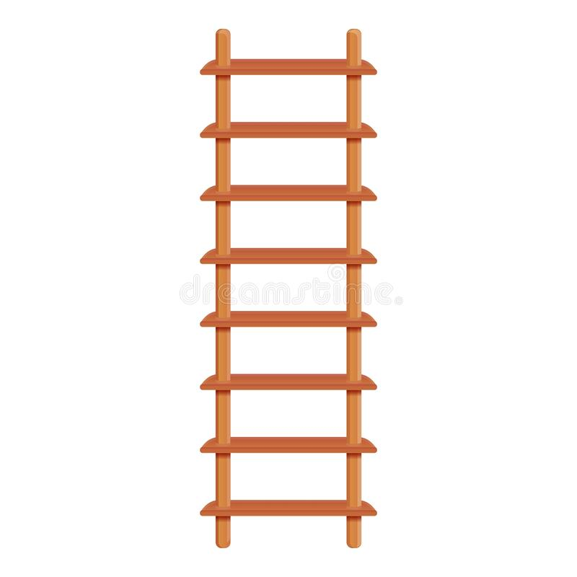
An Analogy
Consider an infinitely long ladder

Slide 4

An Analogy
Consider an infinitely long ladder

Slide 5
An Analogy
Consider an infinitely long ladder
Mario has two capabilities (given by the game developer):

Slide 6
An Analogy
Consider an infinitely long ladder
Mario has two capabilities (given by the game developer):
He can reach the first step

Slide 7
An Analogy
Consider an infinitely long ladder
Mario has two capabilities (given by the game developer):
He can reach the first step

Slide 8
An Analogy
Consider an infinitely long ladder
Mario has two capabilities (given by the game developer):
He can climb the first step
If he is at the nth step, then he can go to the (n+1)th step

Slide 9
An Analogy
Consider an infinitely long ladder
Mario has two capabilities (given by the game developer):
He can climb the first step
If he is at the nth step, then he can go to the (n+1)th step

Slide 10
An Analogy
Consider an infinitely long ladder
Mario has two capabilities (given by the game developer):
He can climb the first step
If he is at the nth step, then he can go to the (n+1)th step
CAN HE CLIMB TO ANY
STEP OF THE LADDER??

Slide 11
INTRODUCING MATHEMATICAL INDUCTION

Slide 12
Introducing Mathematical Induction
PRINCIPLE OF MATHEMATICAL INDUCTION
To prove that P(n) is true for all positive integers n, where P(n) is a propositional function, we complete two steps:
BASIS STEP: We verify that P(1) is true.
INDUCTIVE STEP: We show that the conditional statement P(k) → P(k + 1) is true for all positive integers k
We can extend this definition to non-negative integers or subsets of the set of integers

Slide 13
Introducing Mathematical Induction
USES OF MATHEMATICAL INDUCTION
Proving the formula for a series
Proving inequalities
Proving Divisibility

Slide 14
PROVING THE FORMULA FOR A SERIES

Slide 15
Proving the formula for a series
1³ + 2³ + ⋯ + n³ = (n(n + 1)/2)² for the positive integer n
for all positive integers n
Prove that 1 ⋅ 1! + 2 ⋅ 2! + ⋯ + n ⋅ n! = (n + 1)! − 1 whenever n is a positive integer

Slide 16
PROVING INEQUALITIES

Slide 17
Proving Inequalities
Prove that n² − 7n + 12 is non-negative whenever n is an integer with n ≥ 3

Slide 18
PROVING DIVISIBILITY

Slide 19
Proving Divisibility
Prove that 3 divides n³ + 2n whenever n is a positive integer
Prove that 6 divides n³ − n whenever n is a nonnegative integer.

Slide 20
PRACTICE PROBLEMS

Slide 21
Practice Problems
Book : Discrete Math and Its Applications Eighth Edition
Author: Kenneth H. Rosen
Chapter : 5.1
Problems : 3,4,5,6,7,8,12,13,14,15,16,17,18,19,20,21,24,28,31,32,33,34

Slide 22
Thank You

